Slide 1
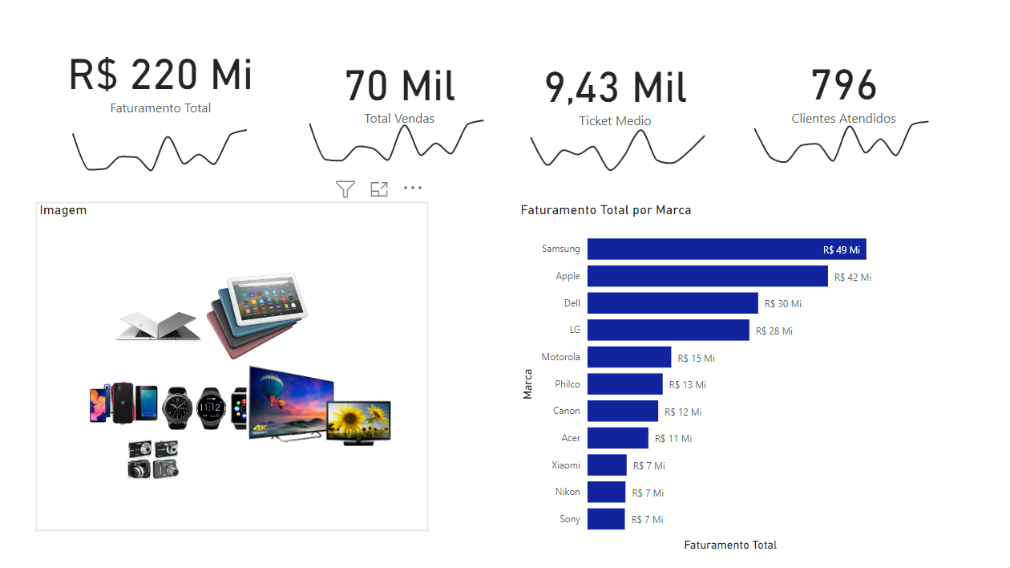




Hashtag Dashboard Vendas

